Slide 1
Washington County Crash Data
Nagham - 202110560
Kinda - 202110811

Slide 2
01
02
03
04
Data Cleaning
Relationships
DAX
Visualizations

Slide 3
01
Data Cleaning

Slide 4
What we do in Edit Query ?
In our analysis, we started with seven tables. However, one table was removed, reducing our dataset. Initially, the yearly tables contained 188 columns. After a thorough cleaning process, we eliminated duplicate columns and those with a significant number of missing values. As a result, we refined our dataset down to 79 columns that are relevant for our analysis.
Additionally, some numerical values were converted to text to facilitate easier handling. We also merged certain columns to simplify the dataset further. Finally, all yearly data was consolidated into a new table, which combines all the years for streamlined analysis.

Slide 5
Some of the columns
CRASH_CRN: Unique identifier for each crash incident.
CRASH_COUNTY: County where the crash occurred.
MUNICIPALITY: Municipality or city where the crash occurred.
CRASH_YEAR: Year of the crash.
CRASH_MONTH: Month of the crash.
DAY_OF_WEEK: Day of the week of the crash.
HOUR_OF_DAY: Hour of the crash (24-hour format).
WEATHER: Weather conditions at the time of the crash.
ROAD_CONDITION: Condition of the road during the crash.
URBAN_RURAL: Indicates if the crash was in an urban or rural area.
LOCATION_TYPE: Type of location (e.g., intersection, highway).
PERSON_COUNT: Total number of people involved in the crash.
VEHICLE_COUNT: Total number of vehicles involved.
FATAL_COUNT: Total fatalities in the crash.
INJURY_COUNT: Total injuries in the crash.
ALCOHOL_RELATED: Indicates if the crash was alcohol-related.

Slide 6
02
Relationships

Slide 7
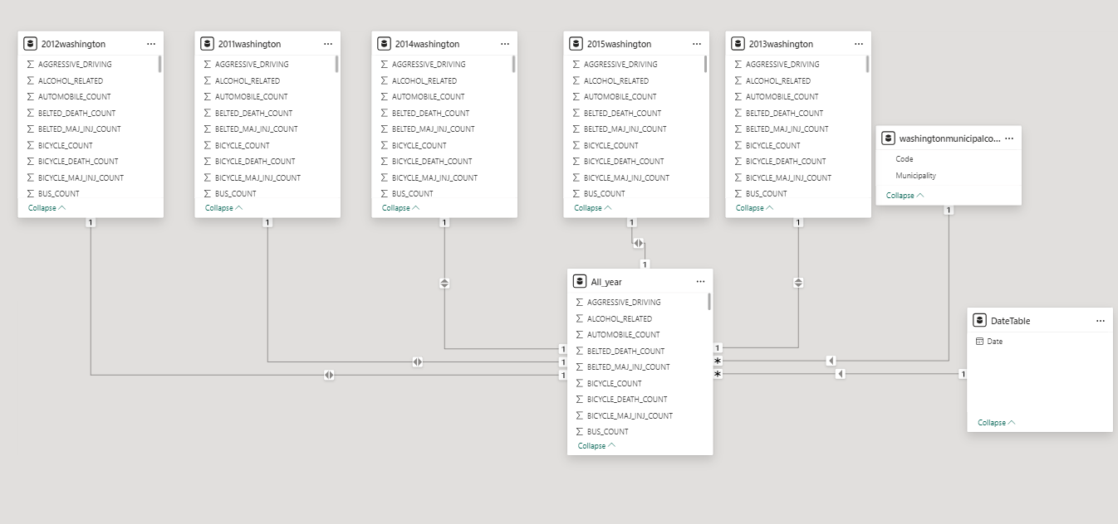

Slide 8
03
DAX

Slide 9
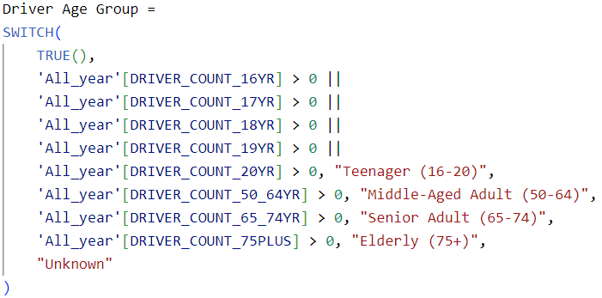
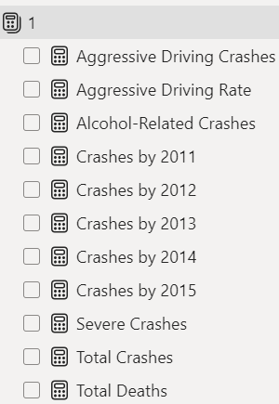
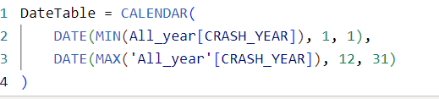
New Column
New Measures
New Table

Slide 10
04
Visualizations

Slide 11
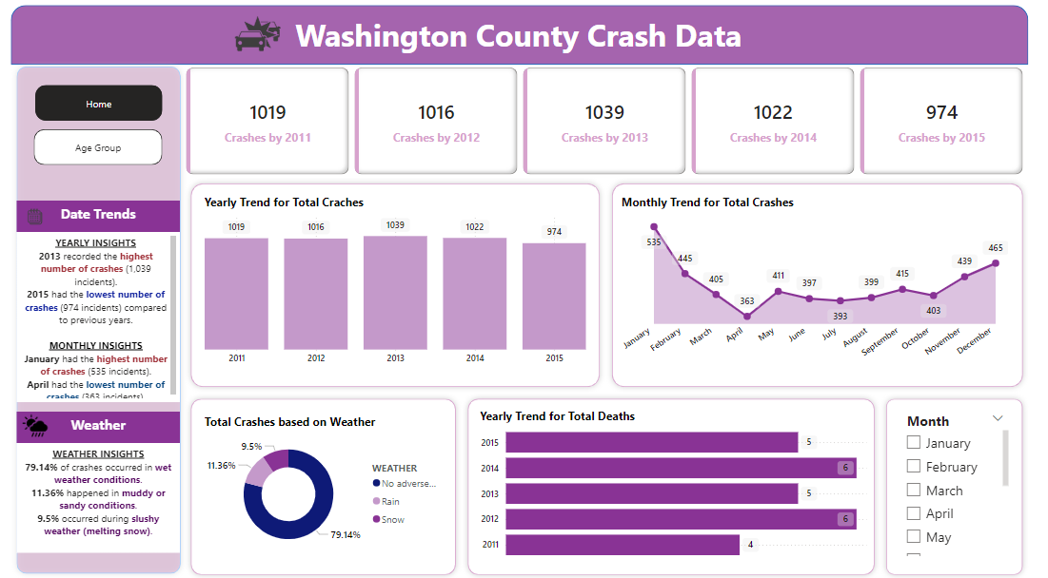

Slide 12
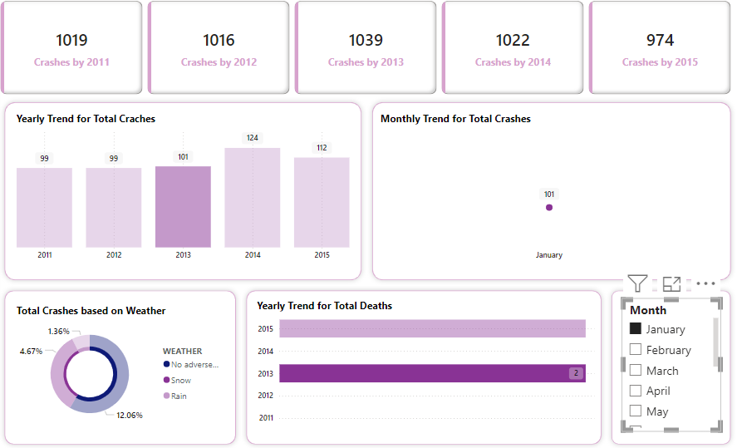
1. Total Accidents in 2013:
The data shows there were 101 accidents in January 2013.
This represents a slight increase compared to 99 accidents in the previous year (2012).
2. Monthly Trends:
The monthly trend indicates that January experienced a moderate number of accidents compared to other months listed (February and beyond).
3. Weather Impact:
The chart shows approximately 12% of accidents were related to weather conditions, such as snow or rain.
Notably, other accidents occurred under normal weather conditions (no adverse weather).
4. Fatalities:
The fatalities chart indicates there were 2 recorded deaths from accidents in 2013.
This highlights an ongoing concern for road safety during that year.

Slide 13
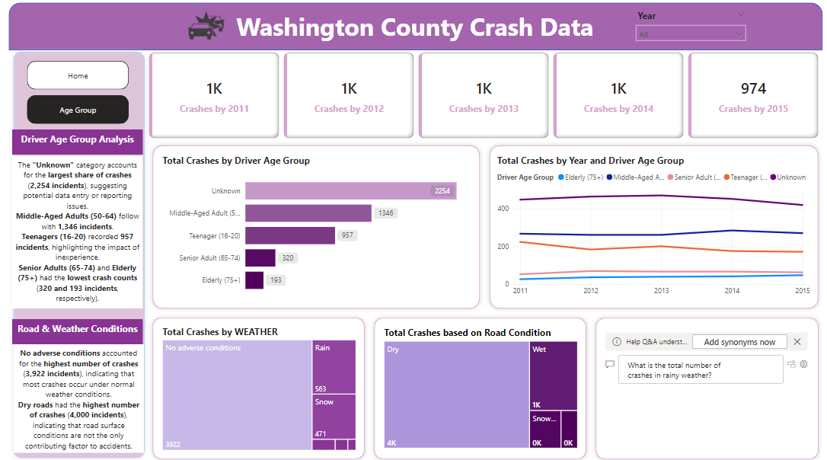

Slide 14
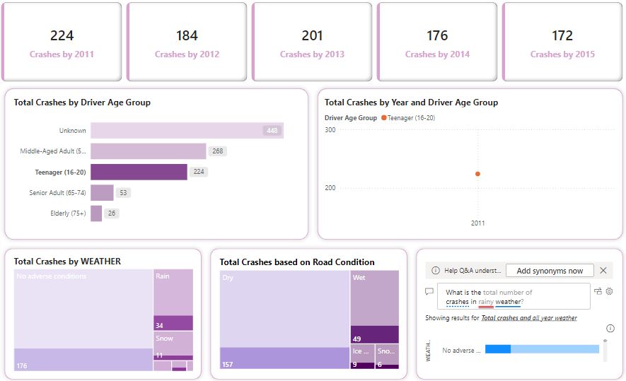
1. Total Crashes in 2011:
In 2011, there were 224 crashes involving teenagers (age group 16-20).
This is a significant portion compared to other age groups.
2. Age Group Breakdown:
Teenagers (16-20) accounted for 224 crashes, making them the third-largest group after "Unknown" drivers (448) and "Middle-Aged Adults" (268).
This indicates that teen drivers are heavily represented in crash statistics for that year.
3. Trends Over Time:
The visual shows that the number of crashes for teenagers in 2011 is the highest compared to the following years up to 2015, with numbers decreasing in subsequent years:
2012: Noted decrease, 184 crashes.
2013: Slight increase, 201 crashes.
2014: Decline to 176 crashes.
2015: Further decline, 172 crashes.
4. Weather Conditions:
The data indicates that out of 224 crashes, only 34 occurred during rainy conditions, suggesting that the majority of crashes occurred under dry conditions.
49 crashes were reported on wet roads, which is significant but indicates that many crashes occurred without adverse weather factors.

Slide 15
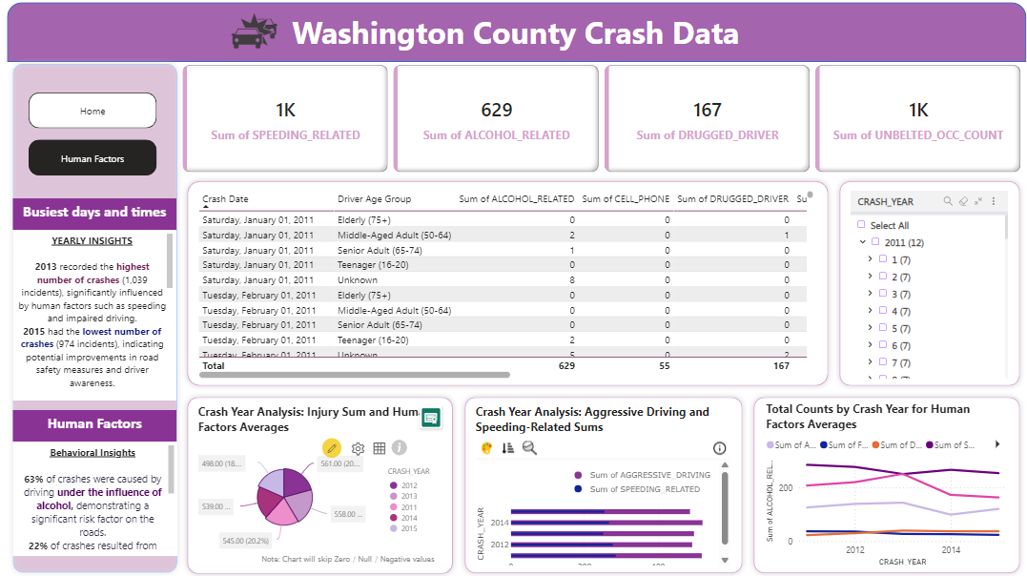

Slide 16
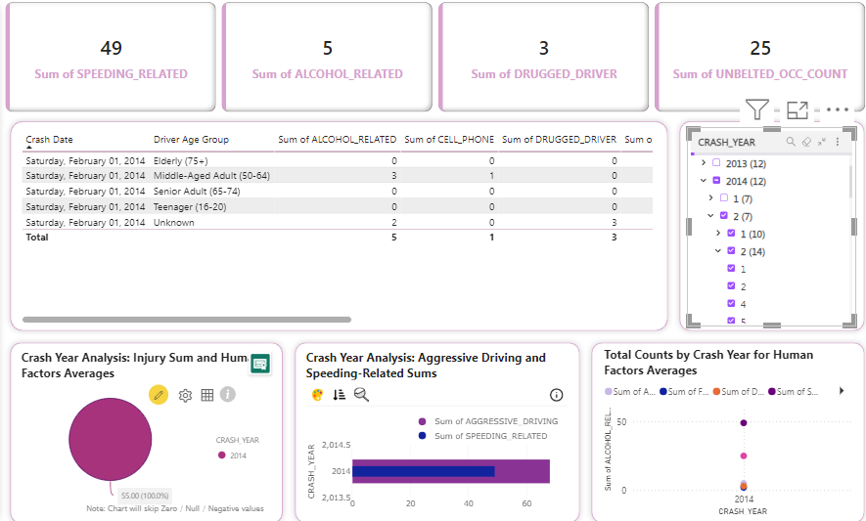
1. Total Crashes Overview:
In 2014, there is a total of 12 crashes reported in the data, indicating a steady situation compared to previous years (12 in 2013 as well).
2. Speeding-Related Incidents:
There were 49 speeding-related crashes, which is a significant indicator of aggressive driving behavior and a clear focus area for enhancing road safety measures.
3. Alcohol and Drug Involvement:
The data indicates that there were 5 alcohol-related incidents and 3 drug-related incidents:
This suggests that while alcohol remains a concern, the number of drug-related incidents is notably lower.
4. Teenager Participation:
Among the different age groups, teenagers accounted for 2 reported crashes, showing they remain a critical group in traffic safety discussions.
5. Seatbelt Use:
There were 25 instances of unbelted occupants in crashes, emphasizing the need for campaigns promoting seatbelt usage.
6. Use of Cell Phones:
Only 1 incident was related to cell phone use, but this low value might not reflect the actual prevalence of distraction-related crashes, which can be underreported.
7. Diversity of Driver Age Groups:
The crashes involve various age groups, including:
Elderly drivers showing 0 related incidents.
Middle-aged adults (3), and senior adults (4) have a varied impact.

Slide 17
Thank you !

